Slide 1

SOCIAL ANALYSIS
GNED 500
WEEK 6
Photo by Amine M'Siouri from Pexels

Slide 2

Acknowledgement
Traditional Lands
Canada Map Vectors by Vecteezy
Notes:
Acknowledgement of Traditional Lands
Centennial is proud to be a part of a rich history of education in this province and in this city.
We acknowledge that we are on the treaty lands and territory of the Mississauga’s of the Credit First Nation and pay tribute to their legacy and the legacy of all First Peoples of Canada, as we strengthen ties with the communities we serve and build the future through learning and through our graduates.
Today the traditional meeting place of Toronto is still home to many Indigenous People from across Turtle Island and we are grateful to have the opportunity to work in the communities that have grown in the treaty lands of the Mississauga’s.
We acknowledge that we are all treaty people and accept our responsibility to honor all our relations

Slide 3

AGENDA
Learning Outcomes
A ZEN Buddhist Fable
What is Social Analysis
Social Analysis and Critical Thinking
Critical Thinking
Social Analysis Importance
Ideologies and Social Institutions
Hegemonic Discourse
Structure of Power
Social Analysis Model – Triangle Model
Discourse and Social Analysis
Historical Context(s)
Individual & community Perceptions
Ideologies
Dominant Discourses
Institutional Perpetuation
Learning
Responses to social Problems
Resistance to Social Issues
Summary & Questions
Check 3d by d3images - freepik.com
Notes:
AGENDA
Land Acknowledgement
Learning Outcomes
A ZEN Buddhist Fable
What is Social Analysis
Social Analysis and Critical Thinking
Critical Thinking
Social Analysis Importance
Ideologies and Social Institutions
Hegemonic Discourse
Structure of Power
Social Analysis Model – Triangle Model
Discourse and Social Analysis
Historical Context(s)
Individual & community Perceptions
Ideologies
Dominant Discourses
Institutional Perpetuation
Learning
Responses to social Problems
Resistance to Social Issues
Summary & Questions

Slide 4

LEARNING OUTCOMES
At the end of this session, you will be able to:
Explain the concepts of dominant discourses and their connection to dominant ideologies
Examine how institutions employ dominant discourses to obscure our understanding of social problems
Identify hegemonic/dominant discourses that normalize social problems
Examine the interconnection between institutions, dominant ideologies and discourses and how these function as Structures of power
LEARNING
OUTCOMES
Vector by pch.vector - freepik.com
Notes:
We will be learning about social analysis
The learning outcomes this week are as follows
Explain the concepts of dominant discourses and their connection to dominant ideologies
Examine how institutions employ dominant discourses to obscure our understanding of social problems
Identify hegemonic/dominant discourses that normalize social problems
Examine the interconnection between institutions, dominant ideologies and discourses and how these function as Structures of power

Slide 5

Zen Buddhist fable
“You cannot fill something until it is empty!”
You have come here to learn about us, but your mind is full of your own ideas and assumptions.
You cannot know us until you know yourself.
Go empty your mind and then we can talk as equals.
The elder points out the scholar’s inability to see beyond a particular set of ideas and assumptions
Photo by Pixabay – Pexel.com
Notes:
A British anthropologist has travelled deep into a forested region to study a people he and other colonizers regard as “uncivilized.”
This Indigenous group does not know poverty or hunger as their land provides for their needs.
After living among the people for some time, the scholar has got to know one of the elders very well.
They often sit and have long conversations over a special bush tea prepared by the elder.
During one such conversation, the British scholar shares his views on the virtues of European culture, the value of progress and hard labour, and how wealth leads to individual happiness.
The elder listens but says nothing. As the scholar winds up, the elder begins refilling their teacups.
But this time, when the cup is filled to the brim, she keeps pouring.
The tea spills over onto the table. Still she pours.
The scholar is dumbfounded. “What in the world are you doing?” he exclaims. “The cup is already full! There’s no room for more tea!”
The elder replies, “That is exactly the point.”
She continues, “You have come here to learn about us, but your mind is full of your own ideas and assumptions.
You cannot know us until you know yourself. Go empty your mind and then we can talk as equals.”
As they both retreat into silence, the scholar thinks, “There’s no helping some people,”
while the elder thinks, “How can this man know so much and so little?”
In this parable, the elder points out the scholar’s inability to see beyond a particular set of ideas and assumptions. Even as he lives in the village, collecting information
and asking questions, the scholar filters what he learns through dominant ideologies we would now call Eurocentrism, capitalism and white supremacy.
These ideas construct and represent Indigenous peoples as inferior savages (and were used to justify dispossession, slavery and genocide).
The scholar was there to learn, but his learning was limited by his core beliefs and mental models, which are deeply ingrained.
Now consider: How might our filters affect how we view social problems?

Slide 6

What Is Social Analysis?
Social analysis is a critical thinking strategy for understanding social problems
It examines why people have conflicting views about the causes and solutions to social problems.
It also considers why harmful conditions continue despite efforts to bring about positive social change.
Analytics by Storyset - freepik.com
Notes:
Social analysis is a critical thinking strategy for understanding social problems
It examines why people have conflicting views about the causes and solutions to social problems.
It also considers why harmful conditions continue despite efforts to bring about positive social change.

Slide 7

Social analysis is about asking the right questions? not getting the right answers!
Photo by creativeart - freepik.com
Notes:
Social analysis is about asking the right questions?
Not getting the right answers!

Slide 8

Social ANALYSIS
It is about looking at an issue from all angles in order to understand how to best approach and, eventually, to attempt to solve a social problem.
Photo by Artem Podrez from Pexels
Notes:
Social analysis is not about finding the right answer.
It is about looking at an issue from all angles in order to understand how to best approach and, eventually, to attempt to solve a social problem.

Slide 9

SOCIAL ANALYSIS Critical Thinking & Identity
To engage in social analysis, we must be aware of our own identities and how they are positioned in society
This identity is socially constructed, and thus influenced by history, ideology, social institutions, etc…
Image by vectorjuice - freepik.com
Notes:
As the fable that opened this module showed, how we see and experience the world is filtered through our social identity.
This identity is socially constructed, and thus influenced by history, ideology, social institutions, and the like.
Through socialization, we develop perceptual filters that shape our attitudes, beliefs, and behaviours.
We are exposed to dominant ideas and practices that affect our thinking patterns and social experiences.
These, in turn, form our biases, stereotypes and prejudices, which influence our behaviours towards others and our interpretation of events.
Due to confirmation bias, we tend to reinforce these beliefs, rather than question them.

Slide 10
So how do we develop the awareness needed for social analysis?
Photo by creativeart - freepik.com
Notes:
Social analysis is about asking the right questions?
Not getting the right answers!

Slide 11
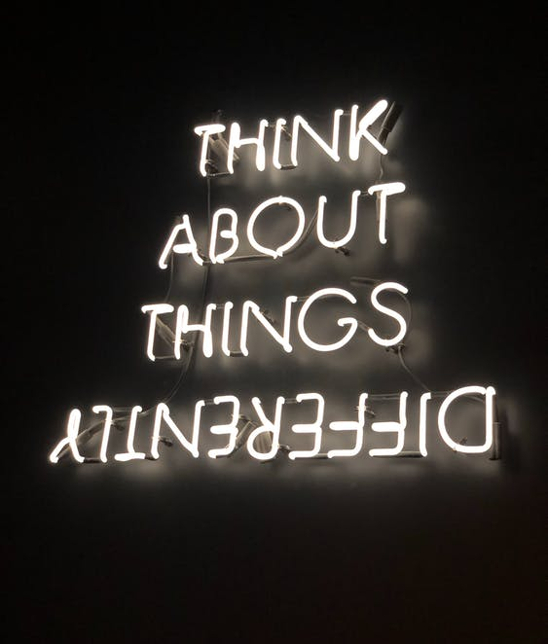

Critical Thinking
Critical thinking is key.
Critical thinkers examine the perceptual filters that may influence their ability to evaluate situations objectively or accurately.
Photo by Ivan Bertolazzi from Pexels
Notes:
Critical thinking is key.
Critical thinkers examine the perceptual filters that may influence their ability to evaluate situations objectively or accurately.
They recognize the need to be knowledgeable about competing ideologies.
This allows them to question the ideas and values they hold.
Critical thinkers know the difference between fact and opinion.
They recognize misinformation and lies.
They draw conclusions that are informed and thoughtful.
Finally, they recognize the need for good research to engage in solid analysis.

Slide 12

Social Analysis Importance
Practice of mindfulness.
Considering the impact that ideas, actions, and behaviours can have
Social analysis is linked to social change.
Challenging discriminatory ideas and participating in the transformation of unjust social and institutional structures.
Questions:
Do we unknowingly engage in the perpetuation of ideas and practices that are harmful?
Do your everyday practices work towards the promotion of fairness and human rights?
Image by Gerd Altmann from Pixabay
Notes:
Social Analysis can be understood as a practice of mindfulness.
It is about considering the deeper implications of the impact that ideas, actions, and behaviours can have.
In this way, social analysis is linked to social change.
It requires challenging discriminatory ideas and participating in the transformation of unjust social and institutional structures.
An important question for those of us who aspire to be globally conscious is: Do we unknowingly engage in the perpetuation of ideas and practices that are harmful or do our everyday practices work towards the promotion of fairness and human rights?

Slide 13

Ideologies & Social Institutions
Dominant ideologies exist and we follow them often without thinking, but where do we pick them up in the fist place?
Media, government, family, friends, and community.
Ideologies are created and maintained through discourses received within social institutions.
Understanding the role of both ideology and social institutions is important for engaging in social analysis.
They help us understanding how the individual acts that we often observe when considering a social problem are rooted within a particular social structure.
Artwork by Kenneth Reaume is licensed under a CC BY-NC-SA 4.0 International License.
Notes:
Dominant ideologies exist and we follow them often without thinking, but where do we pick them up in the fist place?
Media, government, family, friends, and community.
Ideologies are created and maintained through discourses received within social institutions.
Understanding the role of both ideology and social institutions is important for engaging in social analysis.
They help us understanding how the individual acts that we often observe when considering a social problem are rooted within a particular social structure.

Slide 14
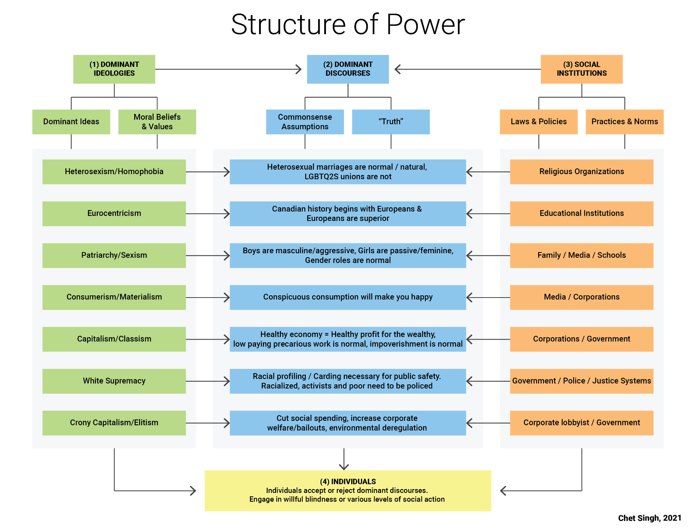
HEGEMONIC DISCOURSE
Hegemonic Discourses obscure social problems making it difficult to change discriminatory and exploitative social structures.
They function to:
Misrepresent, omit and distort facts
Normalize inequality and injustice
Discredit attempts to achieve meaningful structural change
The Structures of Power Diagram by Chet Singh, Centennial College is licensed under a CC BY-NC-SA 4.0 International License.
Notes:
Let’s look at Hegemonic Discourses through the structure of power diagram by Chet Singh.
Hegemonic Discourses obscure social problems making it difficult to change discriminatory and exploitative social structures.
They function to:
Misrepresent, omit and distort facts
Normalize inequality and injustice
Discredit attempts to achieve meaningful structural change

Slide 15


STRUCTURE OF POWER
The Structures of Power Diagram by Chet Singh, Centennial College is licensed under a CC BY-NC-SA 4.0 International License.
Notes:
The Structures of Power Diagram illustrates three interconnected structural foundations that societies are built on:
Dominant ideologies articulate the dominant groups vision about how the society should be organized. (Box # 1)
Social institutions administer the dominant groups ideological vision of society and legislates and legalizes their power and control. (Box # 3)
Dominant discourses reinforce the norms produced by dominant ideologies and institutional practices through common-sense assumptions that shape our understanding of society and social problems. (Box # 2)
This chart links individuals (Box # 4) to structures of power because our consent is required to legitimize these structures and uphold the social order. So, whether we know it or not, we are part of this circuit of power. Power flows through individuals who have agency to accept or reject harmful aspects of the social order. Individuals can keep quiet, speak up or engage in social action when homophobic jokes are made, or when the experiences of these communities are excluded from institutions such as schools.
As the case study of heterosexism demonstrates, structures of power are interconnected. The prejudicial moral beliefs and values of dominant ideologies are operationalized through discriminatory institutional policies, practices and stereotypical norms. These processes have material, social and psychological impacts. They bestow unequal social, legal and economic rewards to privileged groups and minoritized social groups experience systemic inequality, discrimination and violence.
As dominant discourses normalize these discriminatory and destructive ideas, they are woven into the cultural fabric of society and regarded as common-sense or truth. This deflects attention away for the systemic nature of social problems; we learn to blame individuals for systemic failures and social action to change harmful ideas, policies and practices are easier to dismiss. When dominant discourses succeed in framing our understanding of social problems as individual problems, the effect is hegemonic. Hence, dominant discourses are also referred to as hegemonic discourses.
The structures of power diagram can be applied to any social problem to understand how hegemony is achieved in society by dominant groups and why it is difficult to address social problems. Understanding the operation of power is an important requirement for applying triangle model of social analysis.

Slide 16

BREAK
Photo by Chevanon Photography from Pexels
Notes:
15 Minute Break

Slide 17


ATTENDANCE
ATTENDANCE MATTERS
Image by pch.vector - freepik.com
Notes:
This attendance slide can be moved to wherever in your class that you take attendance.
Usually attendance is taken around class breaks, or at the beginning or at the end of class.

Slide 18















DISCOURSE & SOCIAL ANALYSIS
Like ideology, discourse is important to social analysis because discourse is often tied to power.
People with power are able to shape the way we think and talk about things.
Let’s continue to look at Youth Unemployment and unemployment in general through the lens of the triangle model of social analysis
Break – Out Session / Group Work
Artwork by Hi Profile is licensed under a CC BY-NC-SA 4.0 International License.
Notes:
Like ideology, discourse is important to social analysis because discourse is often tied to power.
People with power are able to shape the way we think and talk about things.
Let’s continue to look at Youth Unemployment and unemployment in general through the lens of the triangle model of social analysis
Break – Out Session / Group Work

Slide 19

BREAK OUT SESSION
https://corporatefinanceinstitute.com/resources/knowledge/economics/unemployment
Photo by Ron Lach – Pexels.com
Notes:
https://corporatefinanceinstitute.com/resources/knowledge/economics/unemployment/
Read the article and in groups come up with some ideas
What are some of the issues outlining Youth Unemployment
Consider:
Historical Context+ Individual and Community Experiences + Ideology + Dominant Discourses + Social Institutions
20 – 30 Minutes

Slide 20
YOUTH UNEMPLOYMENT
Photo by Ron Lach – Pexels.com
Notes:
Where/how/why/when did the problem originate?
How has the social problem been challenged historically and by whom?
How has the social problem evolved over time? Have there been changes in laws, norms, practices, and policies that affected it?
Has it been influenced by societal upheavals? Reforms? Revolution?
Why does the problem persist? How is hegemony achieved?
How have powerful groups prevented the social problem from being addressed? Have they made superficial changes that allow them to hold onto power? Or have they used overt institutional power such as the courts, military, or police forces?

Slide 21
QUESTIONS
Where/how/why/when did the problem originate?
How has the social problem been challenged historically and by whom?
How has the social problem evolved over time? Have there been changes in laws, norms, practices, & policies that affected it?
Has it been influenced by societal upheavals? Reforms? Revolution?
Why does the problem persist? How is hegemony achieved?
How have powerful groups prevented the social problem from being addressed? Have they made superficial changes that allow them to hold onto power? Or have they used overt institutional power such as the courts, military, or police forces?
Photo by Ron Lach – Pexels.com
Notes:
Where/how/why/when did the problem originate?
How has the social problem been challenged historically and by whom?
How has the social problem evolved over time? Have there been changes in laws, norms, practices, and policies that affected it?
Has it been influenced by societal upheavals? Reforms? Revolution?
Why does the problem persist? How is hegemony achieved?
How have powerful groups prevented the social problem from being addressed? Have they made superficial changes that allow them to hold onto power? Or have they used overt institutional power such as the courts, military, or police forces?

Slide 22

HISTORICAL CONTEXT
Identifying the historical origins of social problems tells us the context within which a social problem has developed.
For example, before thinking about youth unemployment, it’s important to understand unemployment in general
Image by Unseen Histories on Unsplash
Notes:
For most of us, how we perceive youth unemployment is shaped by dominant discourses in the media and popular culture.
In these discourses, there are three main causes of youth unemployment:
failure of public institutions (i.e. education),
failure of public policy (government),
failure of the individual (too lazy, entitled, or not properly trained) (Source: Toynbee, 2021).
Let’s look at an example of how these dominant discourses sneak into discussions of unemployment

Slide 23
HISTORICAL CONTEXT
Unemployment originated with the development of the economic system of capitalism.
As capitalism evolved in 16th and 17th centuries, labour conditions were very oppressive
Governments made it illegal for workers to organize into unions to improve working conditions
Many union organizers were arrested and killed by the police.
Chronic (continued) unemployment has historically been built into capitalism to keep the power of labour unions in check and keep wages low
Image by Unseen Histories on Unsplash
Notes:
Unemployment originated with the development of the economic system of capitalism.
As capitalism evolved in 16th and 17th centuries, labour conditions were very oppressive
Governments made it illegal for workers to organize into unions to improve working conditions
Many union organizers were arrested and killed by the police.
Chronic (continued) unemployment has historically been built into capitalism to keep the power of labour unions in check and keep wages low
Many citizens are influenced by corporate media and think tanks, such as the Fraser Institute
that produce studies to promote dominant discourses and policies favourable to the economic interests of the wealthy
Government programs are created and exist that hire temporary foreign workers
These programs increase inequality for vulnerable workers such as youth workers,
drive wages down,
create exploitative conditions for foreign workers,
and reduce the ability of workers to organize
In 2017, 24.5% of all employees in the Ontario education sector were temporary, seasonal, casual, term, or on contract ─ representing one of the highest such ratios in the province
Among the academic staff in Ontario colleges, 68% were employed on a part-time basis in 2017/18.
https://www.jobbank.gc.ca/content_pieces-eng.do?cid=15197

Slide 24
HISTORICAL CONTEXT
Many citizens are influenced by corporate media and think tanks, such as the Fraser Institute - that produce studies to promote dominant discourses and policies favourable to the economic interests of the wealthy
Government programs are created and exist that hire temporary foreign workers
These programs increase inequality for vulnerable workers such as youth workers,
drive wages down,
create exploitative conditions for foreign workers,
and reduce the ability of workers to organize
Image by Unseen Histories on Unsplash
Notes:
Unemployment originated with the development of the economic system of capitalism.
As capitalism evolved in 16th and 17th centuries, labour conditions were very oppressive
Governments made it illegal for workers to organize into unions to improve working conditions
Many union organizers were arrested and killed by the police.
Chronic (continued) unemployment has historically been built into capitalism to keep the power of labour unions in check and keep wages low
Many citizens are influenced by corporate media and think tanks, such as the Fraser Institute
that produce studies to promote dominant discourses and policies favourable to the economic interests of the wealthy
Government programs are created and exist that hire temporary foreign workers
These programs increase inequality for vulnerable workers such as youth workers,
drive wages down,
create exploitative conditions for foreign workers,
and reduce the ability of workers to organize
In 2017, 24.5% of all employees in the Ontario education sector were temporary, seasonal, casual, term, or on contract ─ representing one of the highest such ratios in the province
Among the academic staff in Ontario colleges, 68% were employed on a part-time basis in 2017/18.
https://www.jobbank.gc.ca/content_pieces-eng.do?cid=15197

Slide 25
Individuals & Community PERCEPTION
For most of us, how we perceive youth unemployment is shaped by dominant discourses in the media and popular culture.
In these discourses, there are three main causes of youth unemployment:
failure of public institutions (i.e. education),
failure of public policy (government),
failure of the individual (too lazy, entitled, or not properly trained) (Source: Toynbee, 2021).
Let’s look at an example of how these
dominant discourses sneak into discussions of unemployment
Photo by Ron Lach – Pexels.com
Notes:
For most of us, how we perceive youth unemployment is shaped by dominant discourses in the media and popular culture.
In these discourses, there are three main causes of youth unemployment:
failure of public institutions (i.e. education),
failure of public policy (government),
failure of the individual (too lazy, entitled, or not properly trained) (Source: Toynbee, 2021).
Let’s look at an example of how these dominant discourses sneak into discussions of unemployment

Slide 26
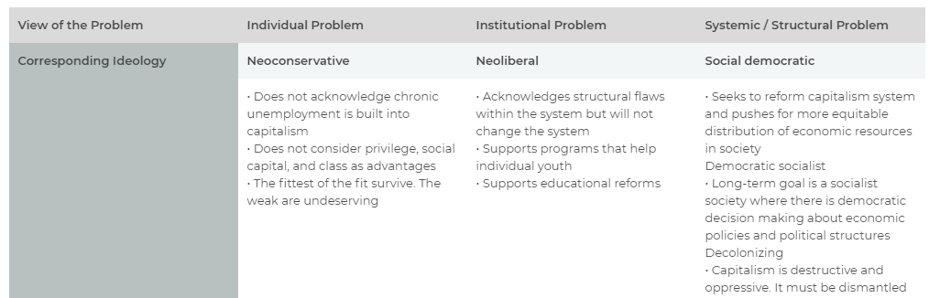
IDEOLOGY
AS IT RELATES TO SOCIAL PROBLEMS
Notes:
Neoconservative – Individual Problem • Does not acknowledge chronic unemployment is built into capitalism • Does not consider privilege, social capital, and class as advantages • The fittest of the fit survive. The weak are undeserving
Neoliberal – Institutional Problem
• Acknowledges structural flaws within the system but will not change the system • Supports programs that help individual youth • Supports educational reforms
Social Democratic – Systemic/Structural Problem
• Seeks to reform capitalism system and pushes for more equitable distribution of economic resources in society
Democratic Socialist – Systemic/Structural Problem
• Long-term goal is a socialist society where there is democratic decision making about economic policies and political structures
Decolonizing – Systemic/Structural Problem
• Capitalism is destructive and oppressive. It must be dismantled

Slide 27
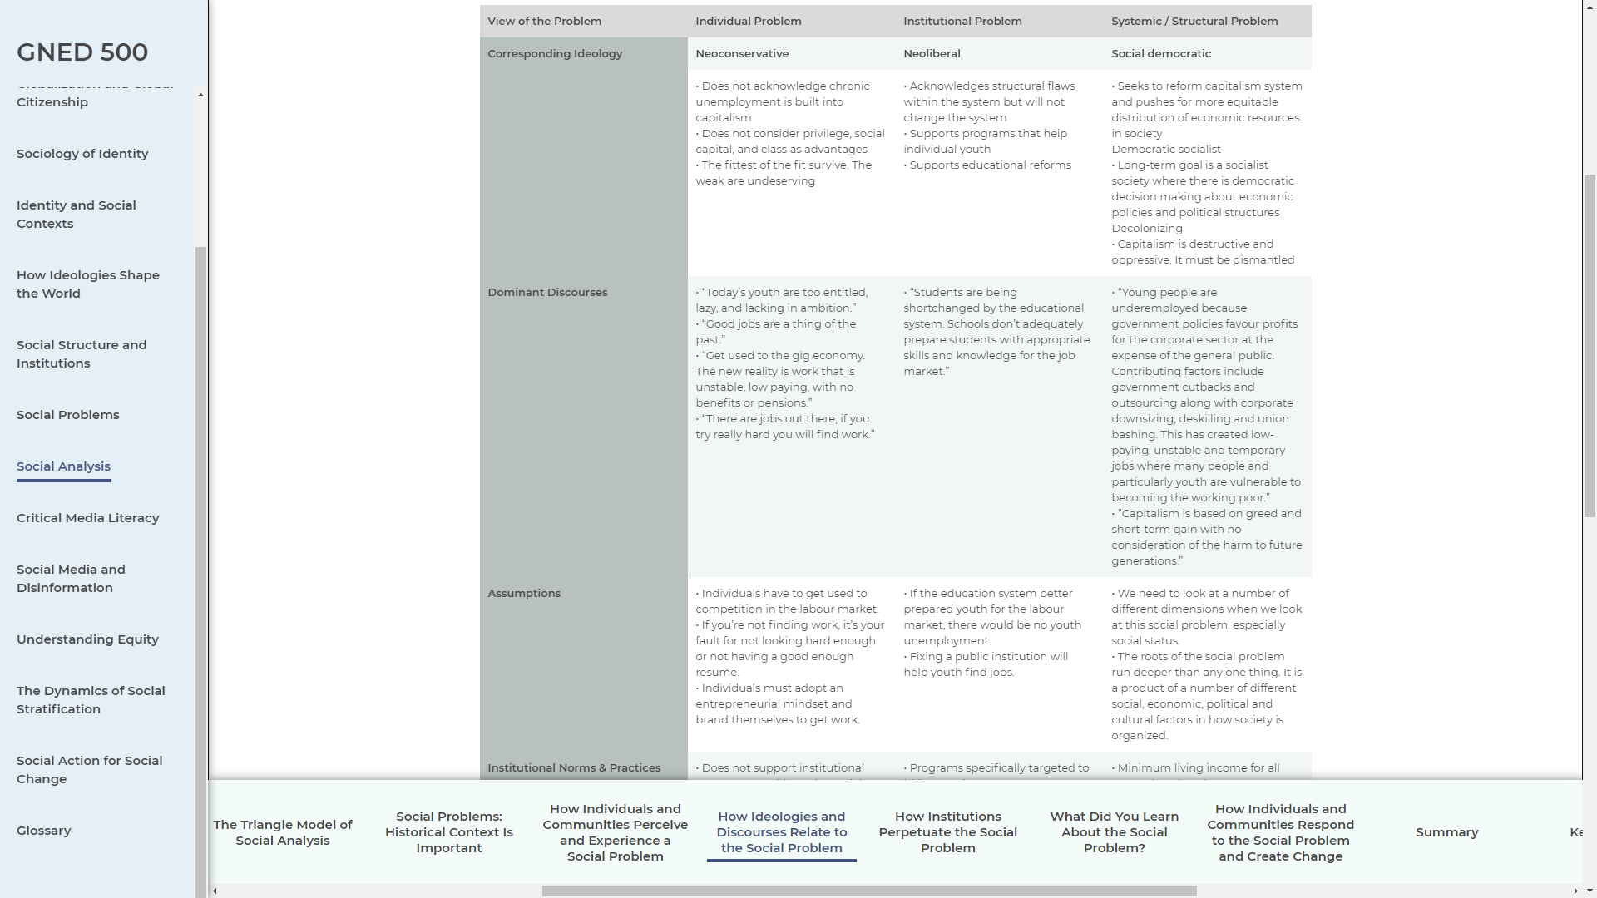
DOMINANT DISCOURSE
AS IT RELATES TO SOCIAL PROBLEMS
Notes:
Neoconservative – Individual Problem • “Today’s youth are too entitled, lazy, and lacking in ambition.” • “Good jobs are a thing of the past.” • “Get used to the gig economy. The new reality is work that is unstable, low paying, with no benefits or pensions.” • “There are jobs out there; if you try really hard you will find work.”
Neoliberal – Institutional Problem
• “Students are being shortchanged by the educational system. Schools don’t adequately prepare students with appropriate skills and knowledge for the job market.”
Social Democratic – Systemic/Structural Problem
• “Young people are underemployed because government policies favour profits for the corporate sector at the expense of the general public. Contributing factors include government cutbacks and outsourcing along with corporate downsizing, deskilling and union bashing. This has created low-paying, unstable and temporary jobs where many people and particularly youth are vulnerable to becoming the working poor.” • “Capitalism is based on greed and short-term gain with no consideration of the harm to future generations.”

Slide 28
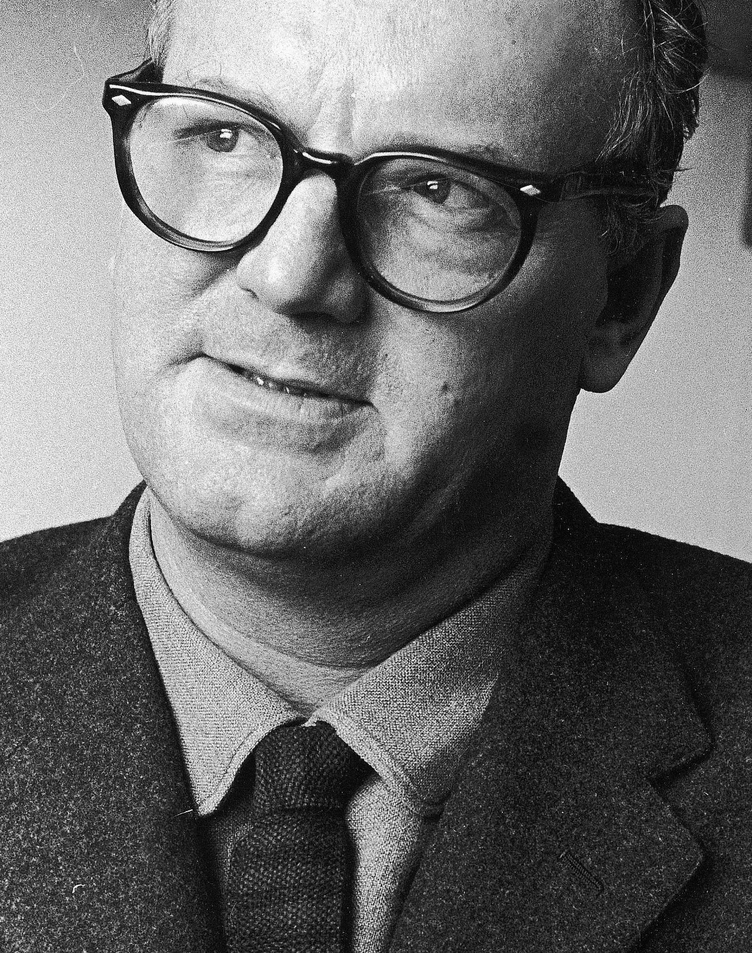
Institutional
Perpetuation
OF SOCIAL PROBLEMS
People with advantages are loath to believe that they just happen to be people with advantages.
They come readily to define themselves as inherently worthy of what they possess; they come to believe themselves ‘naturally’ elite.
– C. Wright Mills
Archive Photos/Stringer/Getty Images - CC BY-SA 4.0
Notes:
People with advantages are loath to believe that they just happen to be people with advantages.
They come readily to define themselves as inherently worthy of what they possess; they come to believe themselves ‘naturally’ elite.
– C. Wright Mills

Slide 29

Institutional Perpetuation
OF SOCIAL PROBLEMS
Education and textbooks also back up this dominant view of work and unemployment.
This is demonstrated in several texts which engage in dominant discourses and myths about work.
For example, if you look hard enough, you will find work regardless of gender, race, or disability.
They also didn’t acknowledge that capitalism creates unemployment and how this affects youth entering the job market.
In this way, these textbooks, and the education system itself, fed into a misrepresentation of the social problem of youth unemployment.
Image by Holger Grybsch from Pixabay
Notes:
Education and textbooks also back up this dominant view of work and unemployment.
This is demonstrated in several texts which engage in dominant discourses and myths about work.
For example, if you look hard enough, you will find work regardless of gender, race, or disability.
They also didn’t acknowledge that capitalism creates unemployment and how this affects youth entering the job market.
In this way, these textbooks, and the education system itself, fed into a misrepresentation of the social problem of youth unemployment.

Slide 30

Institutional Perpetuation
OF SOCIAL PROBLEMS
The textbooks also didn’t spend much time on discrimination in employment hiring practices.
They didn’t explore why workplaces lack diversity.
They didn’t make connections between sexual harassment and the problem of women leaving certain industries.
By excluding these considerations, they demonstrated several dominant discourses and myths about work
Image by Hermann Traub from Pixabay
Notes:
The textbooks also didn’t spend much time on discrimination in employment hiring practices.
They didn’t explore why workplaces lack diversity.
They didn’t make connections between sexual harassment and the problem of women leaving certain industries.
By excluding these considerations, they demonstrated several dominant discourses and myths about work

Slide 31

LEARNING
Social problems are tied to other social issues
We also understand how our individual experiences and perception, ideologies, and social institutions are all bound up together by structures of power, through laws and public policies.
We see how social problems are created and shaped by all of these forces.
Learn photo by rawpixel.com - freepik.com
Notes:
Now that we have explored the different parts of the triangle model, we can see how the social problem we are investigating may end up being far more complex than we initially imagined.
We have a sense of how social problems are tied to other social issues that impact people
We also understand how our individual experiences and perception, ideologies, and social institutions are all bound up together by structures of power, through laws and public policies.
We see how social problems are created and shaped by these forces.

Slide 32

Individuals &
Community RESPONSE
“To avoid the instability of capitalism and its huge social costs requires changing the system.”
– Richard Wolff
Image from
www.rdwolff.com
Notes:
To avoid the instability of capitalism and its huge social costs requires changing the system.
– Richard Wolff
Richard D. Wolff is Professor of Economics Emeritus, University of Massachusetts, Amherst where he taught economics from 1973 to 2008. He is currently a Visiting Professor in the Graduate Program in International Affairs of the New School University, New York City.

Slide 33

RESPONSE
TO SOCIAL PROBLEMS
How individuals and communities respond to a social problem is based on intersecting factors.
These include whether they are personally affected by the problem and the ideologies they hold.
Another factor is whether they understand the effects of social status or have experienced discrimination based on social status.
Photo by Eric Ward on Unsplash
Notes:
How individuals and communities respond to a social problem is based on intersecting factors.
These include whether they are personally affected by the problem and the ideologies they hold.
Another factor is whether they understand the effects of social status or have experienced discrimination based on social status.
For example, conservatives are unlikely to consider youth unemployment a social problem. Conservative think tanks like the Fraser Institute are funded by wealthy donors and argue for keeping minimum wage levels below the poverty level (Sources: Murphy, Lammam, & MacIntyre, 2016; North 99, 2018).

Slide 34
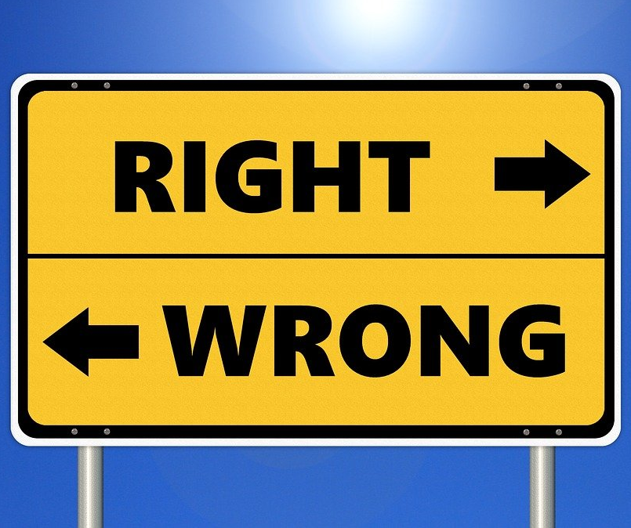
RESPONSE TO SOCIAL PROBLEMS
Based on these factors, some individuals and communities choose to engage in social action to address the problem.
Others ignore it and hope it goes away on its own.
And yet others don’t see it as a problem at all and continue with harmful attitudes, behaviours, and practices.
Image by Tumisu, from Pixabay
Notes:
Based on these factors, some individuals and communities choose to engage in social action to address the problem.
Others ignore it and hope it goes away on its own.
And yet others don’t see it as a problem at all and continue with harmful attitudes, behaviours, and practices.

Slide 35

BREAK
Photo by Kevin Menajang Pexels.com
Notes:
15 Minute Break
This slide can be moved to where you have your class break(s)

Slide 36


Notes:
Black Lives Matter
https://youtu.be/4Vl4I0weXPU

Slide 37

SOCIAL PROBLEMS
INTERSECTION
The complexity and immensity of social problems become clear once we begin to ask critical questions.
What are the impacts?
Who is impacted?
What are the patterns?
How do the impacts differ?
Consider:
social impacts
physical impacts
psychological impacts
economic impacts
institutional impacts
Photo by Warren Wong on Unsplash
Notes:
The complexity and immensity of social problems become clear once we begin to ask critical questions.
What are the impacts?
Who is impacted?
What are the patterns?
How do the impacts differ?
Consider:
social impacts
physical impacts
psychological impacts
economic impacts
institutional impacts

Slide 38

SOCIAL ANALYSIS MODEL
Photo by Luke White on Unsplash

Slide 39
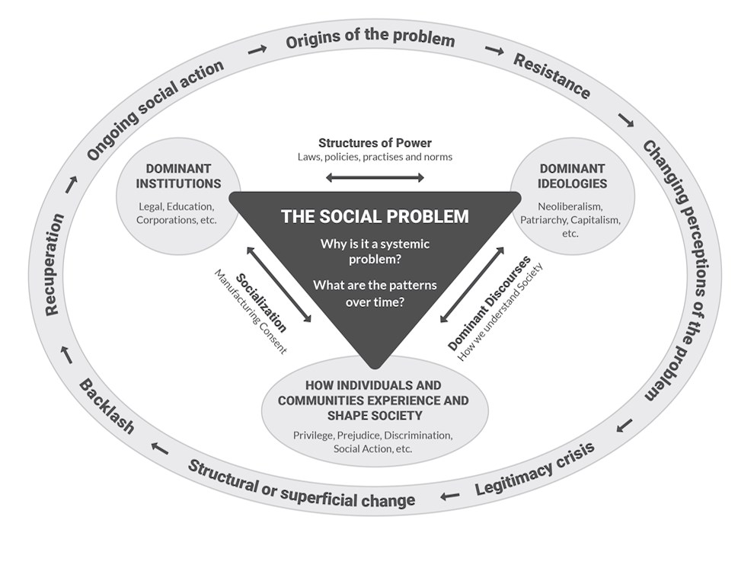
SOCIAL ANALYSIS – TRIANGLE MODEL
Thinking critically about ourselves can help us engage in and see the usefulness of a social analysis of a social problem.
Now, we need to look at how to do a social analysis using a specific model.
We will use the triangle model.
“The Triangle Model of Social Analysis” by Chet Singh, Centennial College is licensed under a CC BY-NC-SA 4.0 International License.
Notes:
Thinking critically about ourselves can help us engage in and see the usefulness of a social analysis of a social problem.
Now, we need to look at how to do a social analysis using a specific model.
We will use the triangle model.
At the peak of the triangle is the individual act. This is what we see, hear, or experience.
A woman losing her job.
A neighbour beating his wife.
A homeless man on the street.
On one side are the ideologies that shape how we understand the problem.
The poor are lazy.
Women are less valuable than men.
The unemployed don’t really want a job.
On the other side are the social institutions that structure or maintain these beliefs.
The media
Education systems
The government
The economy

Slide 40
SOCIAL ANALYSIS
TRIANGLE MODEL OF SOCIAL ANALYSIS
“The Triangle Model of Social Analysis” by Chet Singh, Centennial College is licensed under a CC BY-NC-SA 4.0 International License.
VIDEO
https://soaoer.centennialcollege.ca/gned500/wp-content/uploads/2021/06/TheTriangleModelofSocialAnalysis_3-1.mp4
Notes:
On one side are the ideologies that shape how we understand the problem.
The poor are lazy.
Women are less valuable than men.
The unemployed don’t really want a job.
On the other side are the social institutions that structure or maintain these beliefs.
The media
Education systems
The government
The economy
At the bottom of the triangle is the individual & Communities Experiences.
This is what we see, hear, or experience.
A woman losing her job.
A neighbour beating his wife.
A homeless man on the street.
Individual
Institutions: School, gov who approve the program
Ideologies: theory is more important than practical

Slide 41

SUMMARY
By engaging in social analysis, we are able to find the root causes of social problems.
This allows us to evaluate strategies to address them, change our attitudes or behaviours, and take social action
Photo by Mikhail Nilov from Pexels
Notes:
By engaging in social analysis, we are able to find the root causes of social problems.
This allows us to evaluate strategies to address them, change our attitudes or behaviours, and take social action

Slide 42
SUMMARY
In this module ,we had an intro to social analysis & the triangle model.
Explored importance to recognize our perceptual filters.
Explored the different aspects of the triangle model.
Understand the origins of social problems and why they continue in spite of social action that seeks to create change.
What shapes our perception of social problems.
Considered the role ideologies play.
Lastly, we thought about how institutions can create and maintain social problems through policies, laws and social norms.
Photo by Mikhail Nilov from Pexels
Notes:
In this module, we were introduced to social analysis and the triangle model.
We started by exploring why it is important for us to recognize our perceptual filters.
Then we explored the different aspects of the triangle model.
This model helps us understand the origins of social problems and why they continue in spite of social action that seeks to create change.
We looked at what shapes our perception of social problems.
We considered the role ideologies play.
Finally, we thought about how institutions can create and maintain social problems through policies, laws and social norms.
By engaging in social analysis, we are able to find the root causes of social problems.
This allows us to evaluate strategies to address them, change our attitudes or behaviours, and take social action

